Slide 1
Power Calculator
Project Guide :
Prof. Minu R Nath
Karthik H
TVE20MCA-2034

Slide 2

Introduction
Calculating the electricity consumption, bill and usage of appliances are difficult for common people.
Power Calculator helps to do these tasks easily .
It is a application using PHP to calculate our electricity consumption and its cost.

Slide 3



Main Functionalities
hi
Bill Calculator
Consumption Calculator
Energy Calculator
Calculates the electricity bill amount using the amount of units of consumption.
Calculates the amount of electricity consumption using the bill amount.
Calculates the power usage by particular appliances .

Slide 4
How to calculate ?
KSEB Tariff
The electricity charges of Kerala State Electricity Board are calculated and maintained using Tariff.
The Tariff contains different rates and calculation methods for types of users, phases, taxes etc.
The bill amount and consumption are calculated using the tables given in the Tariff.
There is different types of Tariffs according to the type of consumers.
For example LT-1 is the Low Tension Domestic Tariff, for calculating household charges.
There is a fixed charge, energy charge(per unit) varying according to the amount of consumption.
The final amount is calculated by also adding taxes, meter rent etc.

Slide 5
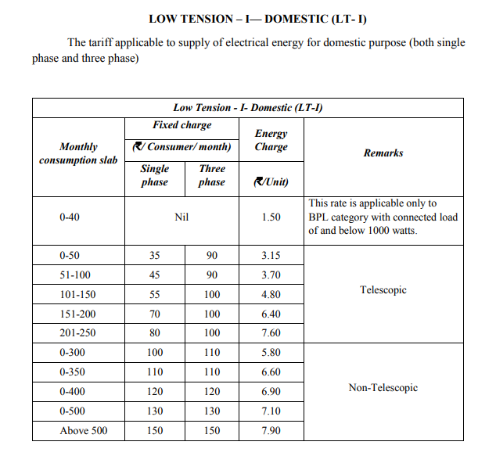
LT-1 Tariff Table

Slide 6
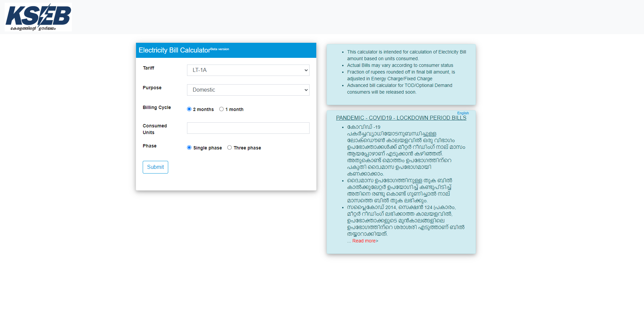
Existing Systems
There is several systems similar to this project
https://www.kseb.in/bill_calculator_v12/
KSEB page that calculates the bill amount.
https://www.ccwater.org.uk/watermetercalculator/
Finds Water bill according to the meter reading.
https://www.bijlibachao.com/electricity-bill/online-electricity-bill-calculator-for-all-states-in-india.html
Calculates domestic bill for differents states.

Slide 7
Proposed System
Calculates the bill and consumption by uploading the readings.
It is hard to find an existing system with consumption calculator.
Also Calculates the Power Consumption of individual appliances.
Admin effectively manages the costs and bill amount across the tariffs.
The database is designed on phpMyAdmin.
Back end using simple PHP and Front end using HTML, CSS etc.

Slide 8
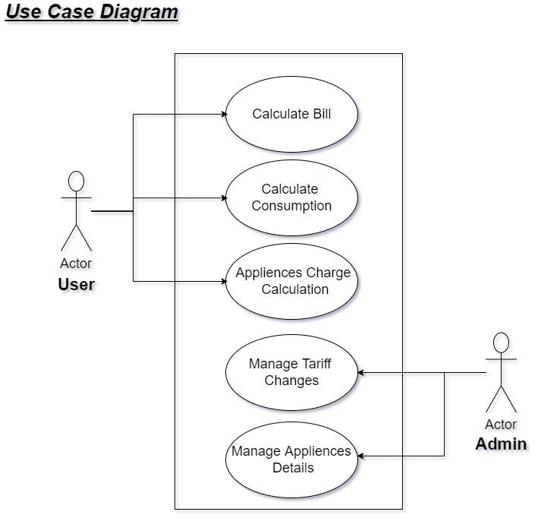
Use Case Diagram

Slide 9
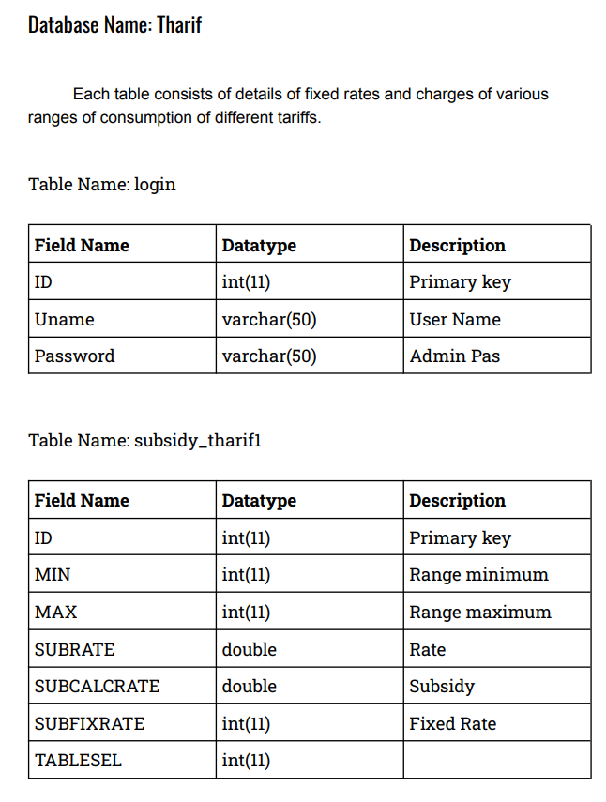
Database Design

Slide 10
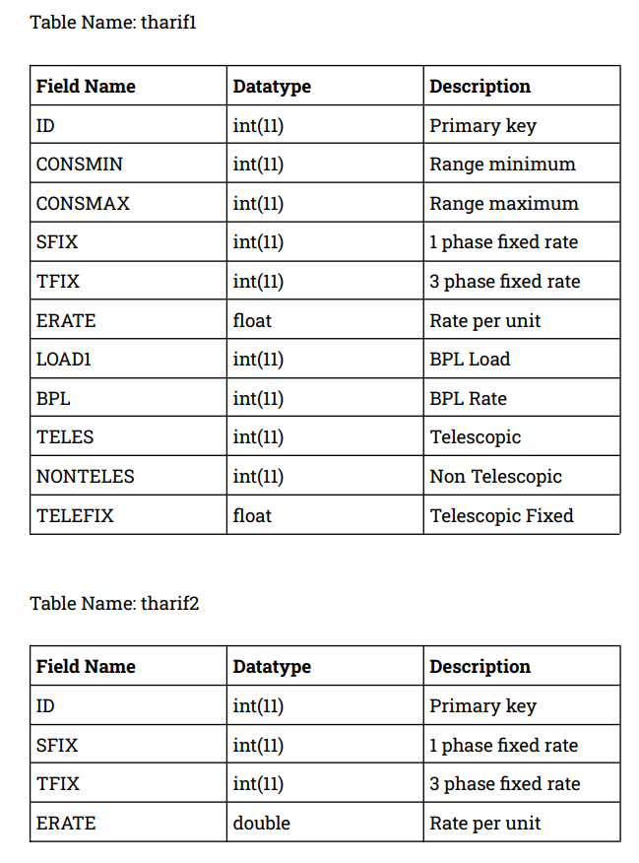
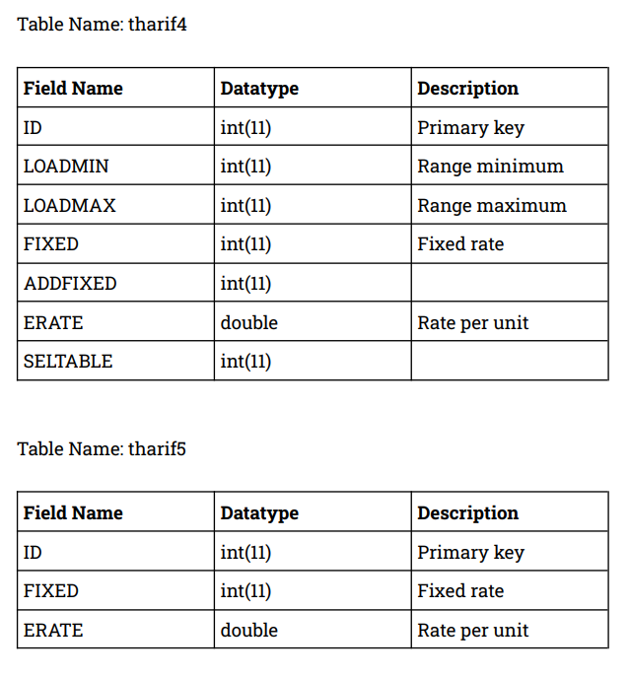

Slide 11
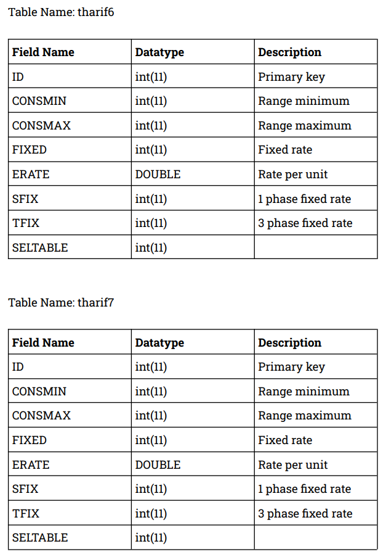
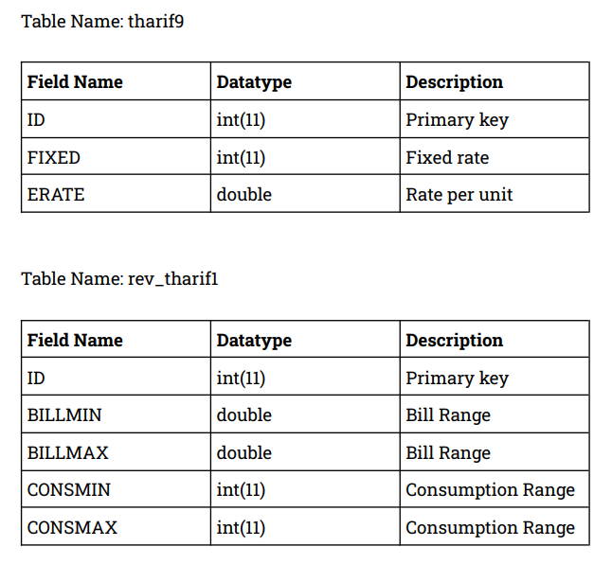

Slide 12
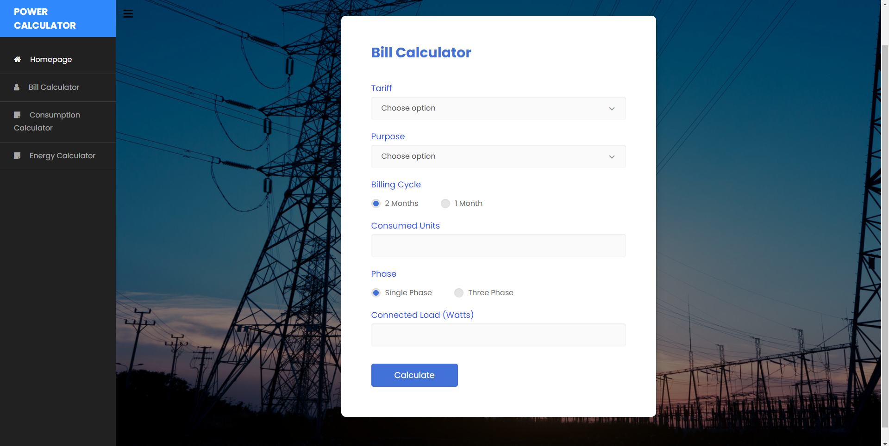
Implementation

Slide 13
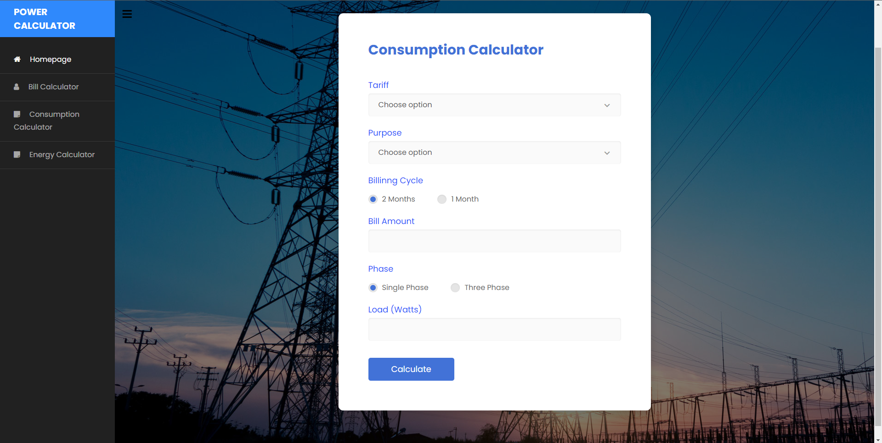

Slide 14
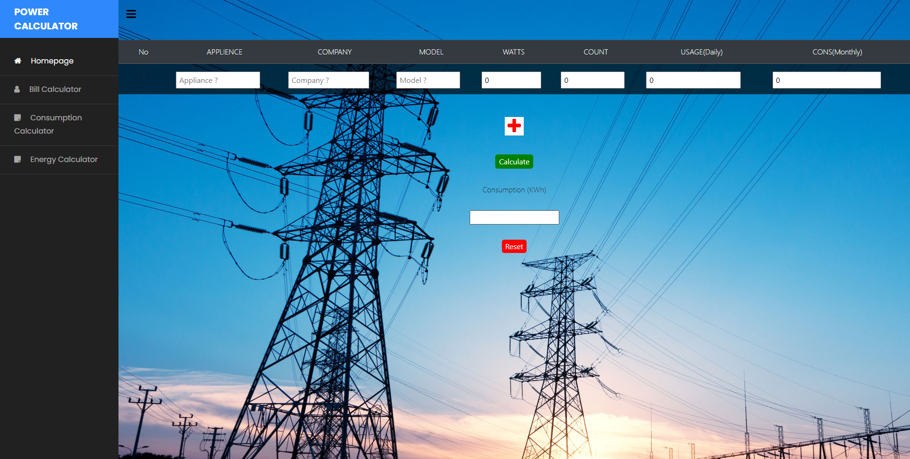

Slide 15
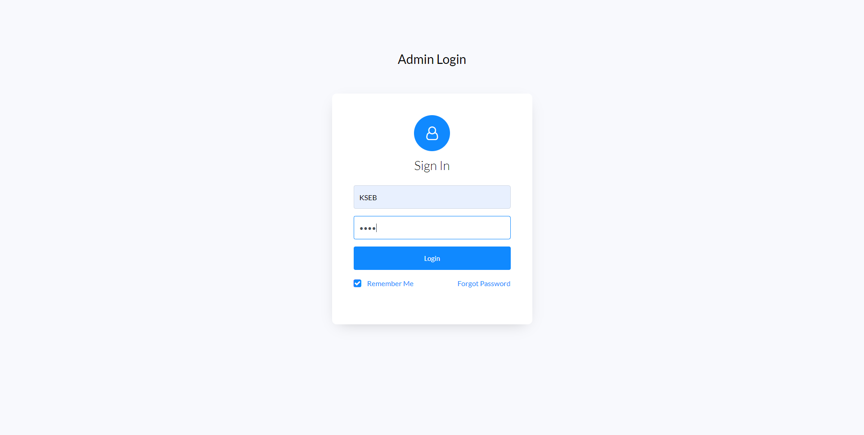

Slide 16
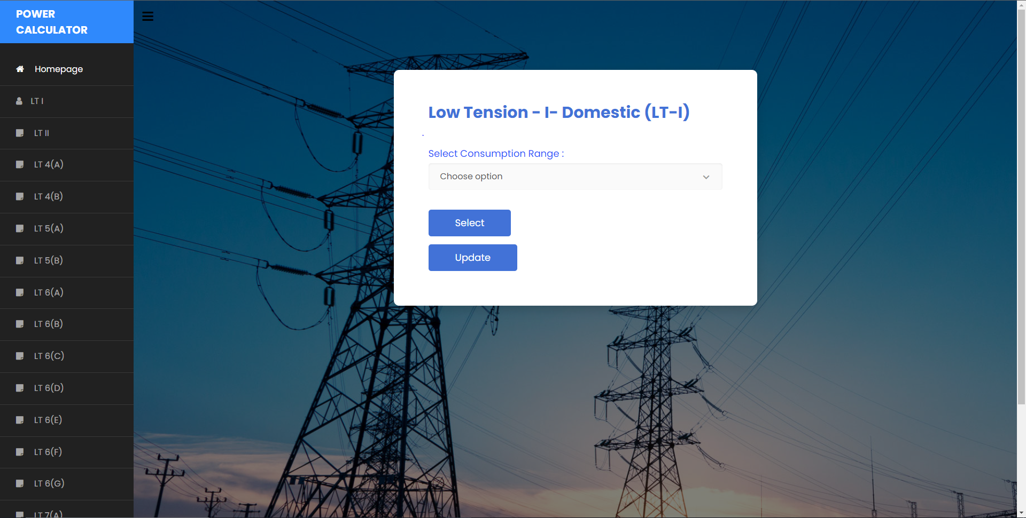

Slide 17
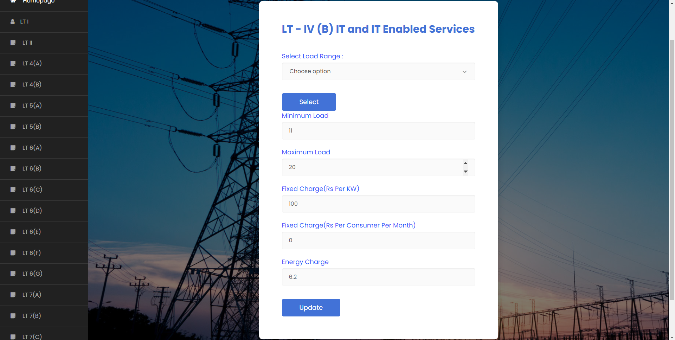

Slide 18
Advantages
Calculates the bill for several Tariffs.
Also finds back the consumption.
Thus, helps in reducing the consumption and bill amount accordingly.
Finding the usage of appliances also helps in efficient power consumption.
Also the user could reduce bill by replacing damaged appliances.

Slide 19
Disadvantages
User has to find the units of consumption from the meter reading to calculate bill(using previous and new reading).
Admin must replace the Tariff changes.
Admin has to insert details of a large number of appliances.
User should have the knowledge about the model and watts of the appliance.

Slide 20
Future Enhancement
Further modifications whatsoever can be done.
Using a feasible method to add appliances by the admin.
Finding out more accurate method and mathematical calculation for finding the consumption from the bill.
Helping the user to limit consumption by giving tips and suggestions.

Slide 21
Conclusion
The electricity consumers can find out their bill and consumption without the help of a professional is the greatest merit of the project.
Any consumer with the consumed units or bill amount or the details of their appliances can calculate.
Common consumers knowing about their consumption amounts can result in reducing electricity usage and hence save energy.

Slide 22
Thank
You

